Slide 1
Rapid Object detection using a boosted cascade of simple features
Paul Viola & Michael Jones
Written by David Cohn

Slide 2
introduction
In this lecture we’ll study a very useful way to detect faces in images very rapidly.
The algorithm is called Viola Jones algorithm.

Slide 3
What is face detection?
given any image, we want to find all the faces in the image.
Same for video.

Slide 4
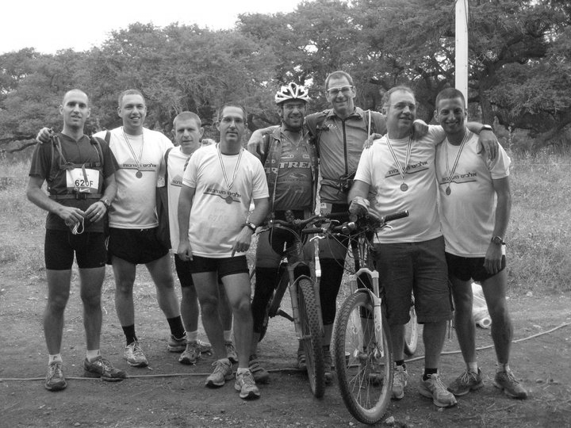
Given the following image:

Slide 5
We’d like to locate the faces like that:

Slide 6

Aurhors
Paul Viola
Got PhD in 1995 from MIT
Current designations:
Manager, Architect, Developer, and Researcher at Microsoft
Professor at MIT
Research Interests are Machine Learning, Web Search and Image Processing
Source link:
http://www.slideshare.net/hirantha129/rapid-object-detection-using-boosted-cascade-of-simple-features

Slide 7
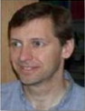
Authors
Michael Jones
Got PhD from Massachusetts Institute of Technology in 1997.
Currently senior member in MERL Research
Research Interests are Computer Vision and Machine Learning.
Source link:
http://www.slideshare.net/hirantha129/rapid-object-detection-using-boosted-cascade-of-simple-features

Slide 8
introduction
We’ll show a very useful algorithm to detect faces in images. The algorithm is called “Viola Jones algorithm”.
The Viola Jones algorithm is very useful of real time applications.
The Viola Jones algorithm uses the AdaBoost machine learning algorithm (for object detections) so we’ll also study the general object detection with AdaBoost algorithm.

Slide 9
adaboost
The face detection system (and also object detection system) uses weak learners constrained to evaluating a single feature.
Weak learner means that its detection quality is slightly better than random guessing.
Since the system uses weak learner, it needs a large number of features in order to describe an object with sufficient accuracy.

Slide 10
adaboost
For each feature in object detection, the weak learner determines the optimal threshold classification function, such that the minimum number of examples are misclassified.

Slide 11
Adaboost
Adaboost (short for “adaptive boosting”) is a machine learning algorithm discovered by Yoav Freund and Robert Schapire.
AdaBoost is an algorithm for constructing a “strong” classifier as linear combination of “simple” “weak” classifier

Slide 12
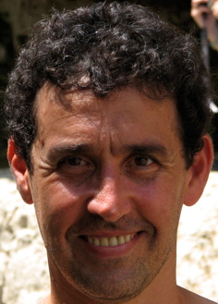
Authors of adaboost
Yoav Freund
A professor of computer science at the University of California.
Main fields: machine learning, probability theory.
Source:
http://en.wikipedia.org/wiki/Yoav_Freund
http://cseweb.ucsd.edu/~yfreund/

Slide 13
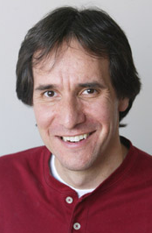
Authors of adaboost
Robert Schapire
A professor of computer science at Princeton University.
Main field is machine learning.
Source:
http://www.princeton.edu/ris/people/
http://en.wikipedia.org/wiki/Robert_Schapire

Slide 14

Adaboost algorithm
Given training set $\left(x_{1},y_{1}\right),…,\left(x_{m},y_{m}\right)$
$y_{i}∈\left\{−1,+1\right\}$ correct/incorrect label of each $x_{i}∈X$
All points initialized to the same weight $w_{i}=\frac{1}{m}$
For t=1,…,T
Construct distribution $D_{t}$ on the m points
Find weak hypothesis $h_{t}:X→\left\{−1,+1\right\}$
With small error $ε_{t}=\sum_{i=1}^{n}{w_{i}\left|h_{t}\left(x_{i}\right)−y_{i}\right|}$

Slide 15

Adaboost algorithm - continue
Constracting $D_{t}$:
$D_{t}\left(i\right)$= $w_{i}$
Given $D_{t}$ and $h_{t}$:
$D_{t+1}\left(i\right)=\frac{D_{t}\left(i\right)}{Z_{t}}$
$D_{t+1}\left(i\right)=\left\{\begin{matrix}\frac{D_{t}\left(i\right)∗exp\left(−αt\right)}{Z_{t}} if y_{i}=h_{t}\left(x_{i}\right) \\ \frac{D_{t}\left(i\right)∗exp\left(αt\right)}{Z_{t}} otherwise\end{matrix}\right.$
$Z_{t}$= normalization constatn (the sum of the weights should be 1)
$α_{t}=\frac{1}{2}ln\left(\frac{1−ε_{t}}{ε_{t}}\right)$>0

Slide 16

Adaboost algorithm - continue
Final hypothesis:
$$H_{final}\left(x\right)=sign\left(\sum_{t=1}^{T}{α_{t}h_{t}\left(x\right)}\right)$$

Slide 17
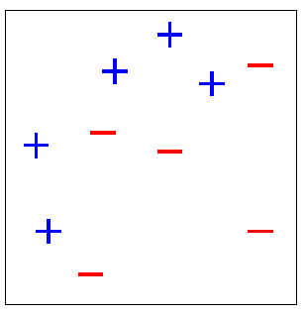
adaboost

Slide 18
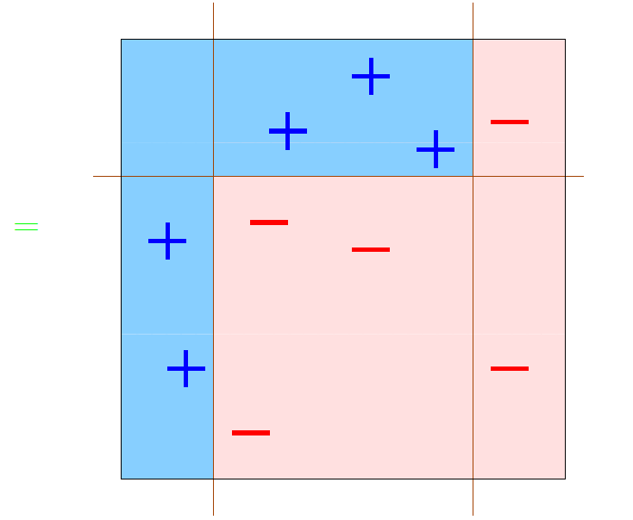
What we want to get:

Slide 19
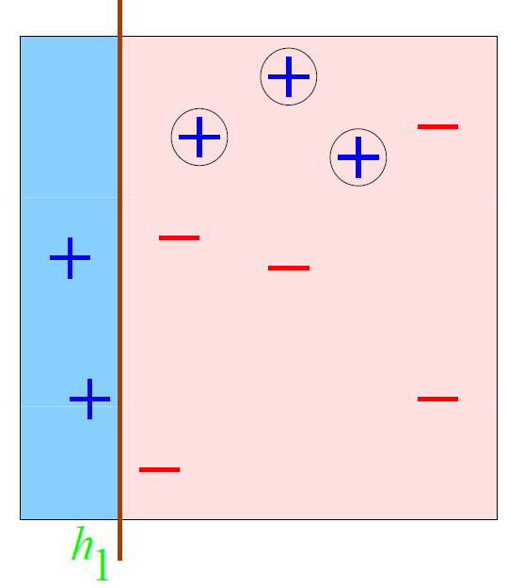
Adaboost - Round 1
3
4
6
5
1
7
8
2
10
9

Slide 20
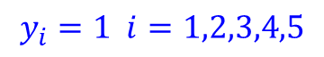
Adaboost - Round 1
$$y_{i}=1 i=1,2,3,4,5$$
3
4
6
5
1
7
8
2
10
9

Slide 21
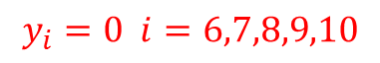
Adaboost - Round 1
$$y_{i}=1 i=1,2,3,4,5$$
3
4
6
$$y_{i}=0 i=6,7,8,9,10$$
5
1
7
8
2
10
9

Slide 22
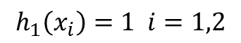
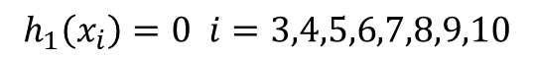
Adaboost - Round 1
$$h_{1}\left(x_{i}\right)=1 i=1,2$$
3
4
6
$$h_{1}\left(x_{i}\right)=0 i=3,4,5,6,7,8,9,10$$
5
1
7
8
2
10
9

Slide 23

Adaboost - Round 1
3
4
There are 10 example points.
At first, each point gets equal weight $\frac{1}{10}$.
$D_{1}\left(i\right)=\frac{1}{10}$ for all i’s
After the first try there are 3 mistakes (points 3,4,5) in which $y_{i}≠h_{1}\left(x_{i}\right)$.
$$y_{i}=1 i=1,2,3,4,5$$
$$y_{i}=0 i=6,7,8,9,10$$
$$h_{1}\left(x_{i}\right)=1 i=1,2$$
$$h_{1}\left(x_{i}\right)=0 i=3,4,5,6,7,8,9,10$$
6
5
1
7
8
2
10
9

Slide 24

Adaboost - Round 1
$ε_{1}=3∗0.1=0.3 (3 mistakes)$ (0.1 is the weight of each mistaken point 3,4,5).
$α_{1}=\frac{1}{2}ln\left(\frac{1−ε_{1}}{ε_{1}}\right)$=$\frac{1}{2}ln\left(\frac{1−0.3}{0.3}\right)=\frac{1}{2}ln\left(\frac{0.7}{0.3}\right)≈0.42$
For i=1,2,6,7,8,9,10:
$D_{2}\left(i\right)=\frac{D_{1}\left(i\right)exp⁡\left(−α_{1}\right)}{Z_{1}}=\frac{0.1∗exp⁡\left(−0.42\right)}{Z_{1}}$=$\frac{0.1∗0.657}{Z_{1}}=\frac{0.0657}{Z_{1}}$
For i=3,4,5:
$D_{2}\left(i\right)=\frac{D_{1}\left(i\right)exp⁡\left(α_{1}\right)}{Z_{1}}=\frac{0.1∗exp⁡\left(0.42\right)}{Z_{1}}$=$\frac{0.1∗1.522}{Z_{1}}=\frac{0.1522}{Z_{1}}$
$$Z_{1}=7∗0.0657+3∗0.1522=0.9165$$
For i=1,2,6,7,8,9,10 $D_{2}\left(i\right)$=$\frac{0.0657}{Z_{1}}$=$\frac{0.0657}{0.9165}=0.0717$
For i=3,4,5 $D_{2}\left(i\right)$=$\frac{0.1522}{Z_{1}}$=$\frac{0.1522}{0.9165}=0.1661$
3
4
6
5
1
7
8
2
10
9

Slide 25
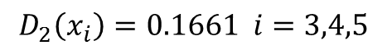
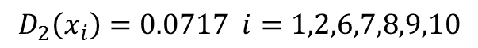
Adaboost - Round 1
$$D_{2}\left(x_{i}\right)=0.1661 i=3,4,5$$
3
4
6
5
$$D_{2}\left(x_{i}\right)=0.0717 i=1,2,6,7,8,9,10$$
1
7
8
The mistaken points 3,4,5 get higher weight next time.
2
10
9

Slide 26
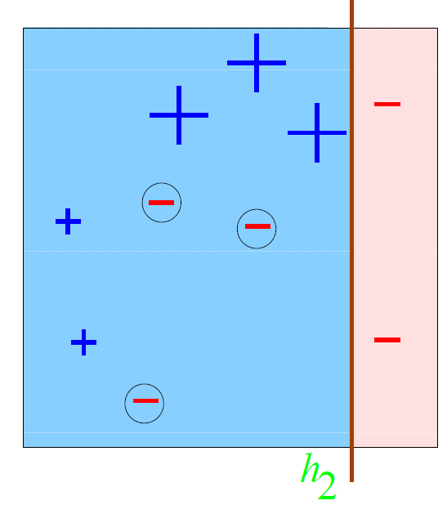

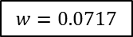
Adaboost - Round 2
$ε_{2}=3∗0.0717=0.215$ (0.0717 is the weight of each of the mistaken points 7,8,9)
$α_{2}=\frac{1}{2}ln\left(\frac{1−ε_{2}}{ε_{2}}\right)$=$\frac{1}{2}ln\left(\frac{1−0.215}{0.215}\right)≈0.65$
For i=3,4,5:
$D_{3}\left(i\right)=\frac{D_{2}\left(i\right)exp⁡\left(−α_{2}\right)}{Z_{2}}=\frac{0.1661∗exp⁡\left(−0.65\right)}{Z_{2}}$=$\frac{0.1661∗0.522}{Z_{2}}=\frac{0.0867}{Z_{2}}$
For i=1,2,6,10:
$D_{3}\left(i\right)=\frac{D_{2}\left(i\right)exp⁡\left(−α_{2}\right)}{Z_{2}}=\frac{0.0717∗exp⁡\left(−0.65\right)}{Z_{2}}$=$\frac{0.0717∗0.522}{Z_{2}}=\frac{0.0374}{Z_{2}}$
For i=7,8,9:
$D_{3}\left(i\right)=\frac{D_{2}\left(i\right)exp⁡\left(α_{2}\right)}{Z_{2}}=\frac{0.0717∗exp⁡\left(0.65\right)}{Z_{2}}$=$\frac{0.0717∗1.9155}{Z_{2}}=\frac{0.1373}{Z_{2}}$
$$Z_{2}=3∗0.0867+4∗0.0374+3∗0.1373=0.822$$
For i=3,4,5 $D_{3}\left(i\right)$=$\frac{0.0867}{0.822}=0.1055$
For i=1,2,6,10 $D_{3}\left(i\right)$=$\frac{0.0374}{0.822}=0.0455$
For i=7,8,9 $D_{3}\left(i\right)$=$\frac{0.1373}{0.822}=0.167$
3
4
6
5
1
7
8
2
10
9
$$w=0.0717$$

Slide 27
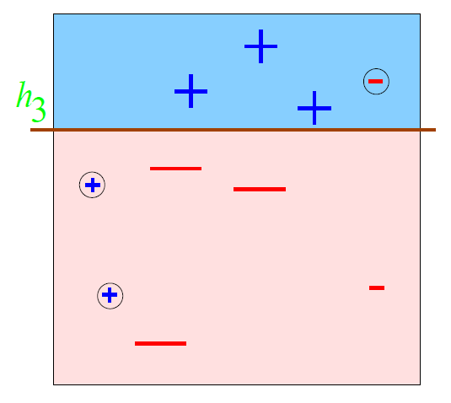

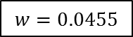
Adaboost - Round 3
4
6
$ε_{3}=3∗0.0455 ≈ 0.14$ (0.0455 is the weight of the mistaken points 1,2,6)
$α_{3}=\frac{1}{2}ln\left(\frac{1−ε_{3}}{ε_{3}}\right)$=$\frac{1}{2}ln\left(\frac{1−0.14}{0.14}\right)≈0.92$
3
5
1
7
8
$$w=0.0455$$
2
10
9

Slide 28
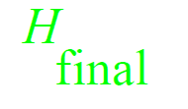
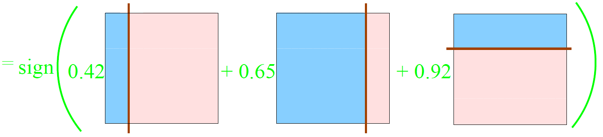

Slide 29
Adaboost algorithm for images

Slide 30
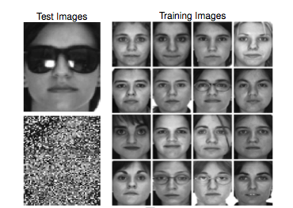
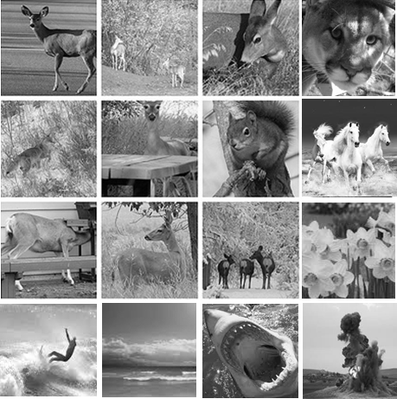


Faces images
Non-faces images
$$y_{i}=1 i=1,2,..,16$$
$$y_{i}=0 i=17,18,..,32$$

Slide 31
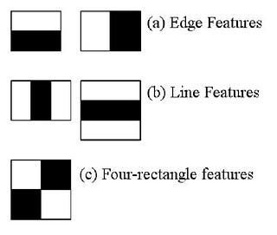
Rectangle features (haar featues)
These are the basic 5 features:
All other features are obtained by change of scale of those 5 features.
Source:
http://www.ece301.com/ml-doc/54-face-detect-matlab-1.html

Slide 32
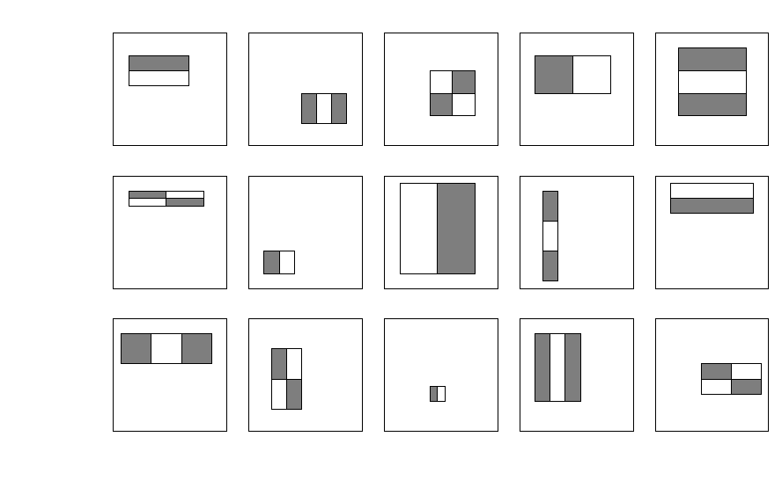
Rectangle features (haar featues)
For 24x24 detection region, there are 162,336 possible features (in all sizes), all based on the base 5 features.
can evaluate:

Slide 33
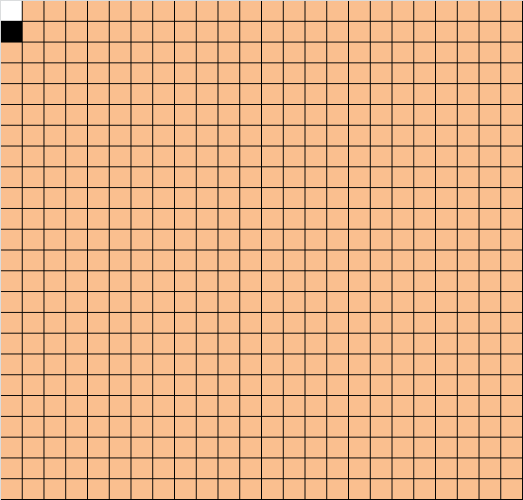
24x24 window

Slide 34
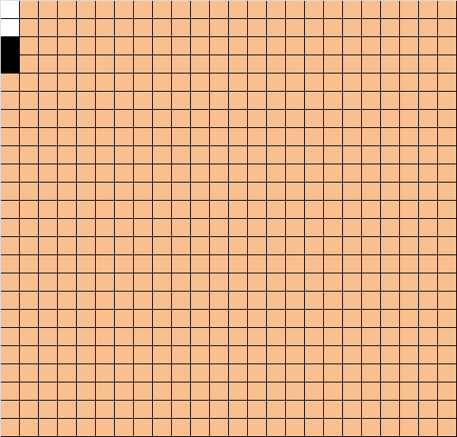
24x24 window

Slide 35
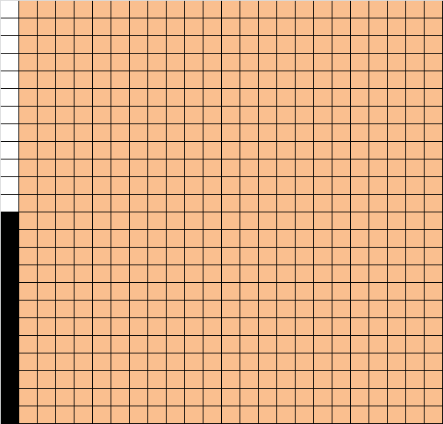
24x24 window

Slide 36
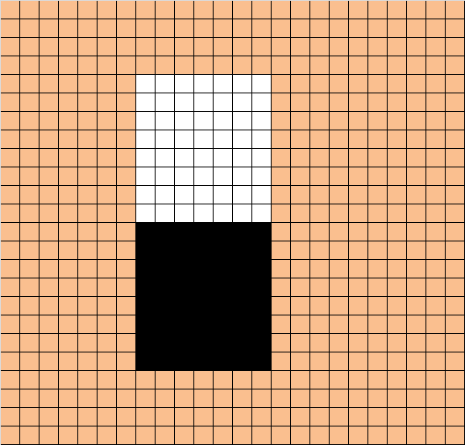
24x24 window

Slide 37
Rectangle features (haar-like features)
We will look for features inside 24x24 pixels window.
Each feature contains black and white rectangles, the feature value is defined by:
∑(pixels in white area)-∑(pixels in black area)
Or in other words, correlation of the image with a mask with 1 in pixels of white areas, and -1 in pixels of black areas.

Slide 38
Face detection – first feature detection
first feature
The region of the eyes is often darker than the region of the nose and cheeks.

Slide 39
Face detection – second feature detection
Second feature:
The eyes are darker than the bridge of the nose.

Slide 40
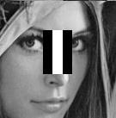
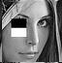
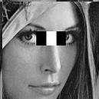
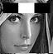
Rectangle features (haar featues)
Some other features correspond to common facial features. Examples:
Eyes darker than the nose
Eyes darker than the chick
Eyes darker than the bridge of nose
Hair is darker than forehead

Slide 41

integral images
Rectangle features can be computed very rapidly using integral image.
Integral image is an image which at location (x,y) contains the sum of the pixels above and to the left of x,y inclusive:
$ii\left(x,y\right)=\sum_{x^{′}≤x, y′≤y}{i\left(x^{′},y′\right)}$
ii(x,y) is the integral image
i(x,y) is the original image

Slide 42
What is integral images - continue
We want to compute ii(x,y) explained above in one pass over the image.
So we do the following calculation:
s(x,y) = s(x,y-1)+i(x,y)
ii(x,y) = ii(x-1,y)+s(x,y)
s(x,y) is the cumulative row sum
s(x,-1)=0, ii(-1,y)=0

Slide 43
What is integral images - example
Let’s assume that i is the following image:
205 | 100 | 90 | 0
200 | 30 | 105 | 80
205 | 100 | 90 | 0
200 | 30 | 105 | 80

Slide 44

What is integral images – example continue
Original image:
Contructing integral image:
$s\left(0,0\right)=\underset{0}{\underbrace{s\left(0,−1\right)}}+\underset{205}{\underbrace{i\left(0,0\right)}}$=205
$ii\left(0,0\right)=\underset{0}{\underbrace{ii\left(−1,0\right)}}+\underset{205}{\underbrace{s\left(0,0\right)}}$=205
205 | 100 | 90 | 0
200 | 30 | 105 | 80
205 | 100 | 90 | 0
200 | 30 | 105 | 80
205

Slide 45

What is integral images – example continue
Original image:
Contructing integral image:
$s\left(0,1\right)=\underset{205}{\underbrace{s\left(0,0\right)}}+\underset{100}{\underbrace{i\left(0,1\right)}}$=305
$ii\left(0,1\right)=\underset{0}{\underbrace{ii\left(−1,1\right)}}+\underset{305}{\underbrace{s\left(0,1\right)}}$=305
205 | 100 | 90 | 0
200 | 30 | 105 | 80
205 | 100 | 90 | 0
200 | 30 | 105 | 80
205 | 305

Slide 46

What is integral images – example continue
Original image:
Contructing integral image:
$s\left(0,2\right)=\underset{305}{\underbrace{s\left(0,1\right)}}+\underset{90}{\underbrace{i\left(0,2\right)}}$=395
$ii\left(0,2\right)=\underset{0}{\underbrace{ii\left(−1,2\right)}}+\underset{395}{\underbrace{s\left(0,2\right)}}$=395
205 | 100 | 90 | 0
200 | 30 | 105 | 80
205 | 100 | 90 | 0
200 | 30 | 105 | 80
205 | 305 | 395

Slide 47

What is integral images – example continue
Original image:
Contructing integral image:
$s\left(0,3\right)=\underset{395}{\underbrace{s\left(0,2\right)}}+\underset{0}{\underbrace{i\left(0,3\right)}}$=395
$ii\left(0,3\right)=\underset{0}{\underbrace{ii\left(−1,3\right)}}+\underset{395}{\underbrace{s\left(0,3\right)}}$=395
205 | 100 | 90 | 0
200 | 30 | 105 | 80
205 | 100 | 90 | 0
200 | 30 | 105 | 80
205 | 305 | 395 | 395

Slide 48

What is integral images – example continue
Original image:
Contructing integral image:
$s\left(1,0\right)=\underset{0}{\underbrace{s\left(1,−1\right)}}+\underset{200}{\underbrace{i\left(1,0\right)}}$=200
$ii\left(1,0\right)=\underset{205}{\underbrace{ii\left(0,0\right)}}+\underset{200}{\underbrace{s\left(1,0\right)}}$=405
205 | 100 | 90 | 0
200 | 30 | 105 | 80
205 | 100 | 90 | 0
200 | 30 | 105 | 80
205 | 305 | 395 | 395
405

Slide 49

What is integral images – example continue
Original image:
Contructing integral image:
$s\left(1,1\right)=\underset{200}{\underbrace{s\left(1,0\right)}}+\underset{30}{\underbrace{i\left(1,1\right)}}$=230
$ii\left(1,1\right)=\underset{305}{\underbrace{ii\left(0,1\right)}}+\underset{230}{\underbrace{s\left(1,1\right)}}$=535
205 | 100 | 90 | 0
200 | 30 | 105 | 80
205 | 100 | 90 | 0
200 | 30 | 105 | 80
205 | 305 | 395 | 395
405 | 535

Slide 50

What is integral images – example continue
Original image:
Contructing integral image:
$s\left(1,2\right)=\underset{230}{\underbrace{s\left(1,1\right)}}+\underset{105}{\underbrace{i\left(1,2\right)}}$=335
$ii\left(1,2\right)=\underset{395}{\underbrace{ii\left(0,2\right)}}+\underset{335}{\underbrace{s\left(1,2\right)}}$=730
205 | 100 | 90 | 0
200 | 30 | 105 | 80
205 | 100 | 90 | 0
200 | 30 | 105 | 80
205 | 305 | 395 | 395
405 | 535 | 730

Slide 51

What is integral images – example continue
Original image:
Contructing integral image:
$s\left(1,3\right)=\underset{335}{\underbrace{s\left(1,2\right)}}+\underset{80}{\underbrace{i\left(1,3\right)}}$=415
$ii\left(1,3\right)=\underset{395}{\underbrace{ii\left(0,3\right)}}+\underset{415}{\underbrace{s\left(1,3\right)}}$=810
205 | 100 | 90 | 0
200 | 30 | 105 | 80
205 | 100 | 90 | 0
200 | 30 | 105 | 80
205 | 305 | 395 | 395
405 | 535 | 730 | 810

Slide 52
What is integral images – example continue
Original image:
integral image:
205 | 100 | 90 | 0
200 | 30 | 105 | 80
205 | 100 | 90 | 0
200 | 30 | 105 | 80
205 | 305 | 395 | 395
405 | 535 | 730 | 810
610 | 840 | 1125 | 1205
810 | 1070 | 1460 | 1620

Slide 53
What is integral images – example continue
ii(x,y) in the integral image is the sum of all the pixels above and to the left in the original image
Original image:
integral image:
205 | 100 | 90 | 0
200 | 30 | 105 | 80
205 | 100 | 90 | 0
200 | 30 | 105 | 80
205 | 305 | 395 | 395
405 | 535 | 730 | 810
610 | 840 | 1125 | 1205
810 | 1070 | 1460 | 1620

Slide 54
integral images
Assume we want to calculate the pixels in the red area.
Original image:
integral image:
205 | 305 | 395 | 395
405 | 535 | 730 | 810
610 | 840 | 1125 | 1205
810 | 1070 | 1460 | 1620
205 | 100 | 90 | 0
200 | 30 | 105 | 80
205 | 100 | 90 | 0
200 | 30 | 105 | 80

Slide 55
integral images
Assume we want to calculate the pixels in the red area.
Original image:
integral image:
A
205 | 305 | 395 | 395
405 | 535 | 730 | 810
610 | 840 | 1125 | 1205
810 | 1070 | 1460 | 1620
205 | 100 | 90 | 0
200 | 30 | 105 | 80
205 | 100 | 90 | 0
200 | 30 | 105 | 80
B
A
B
D
C
C
D

Slide 56
integral images
The sum of the red pixels can be computed as:
A+D-(B+C)=535+1620-(810+1070)=275
Original image:
integral image:
A
205 | 305 | 395 | 395
405 | 535 | 730 | 810
610 | 840 | 1125 | 1205
810 | 1070 | 1460 | 1620
205 | 100 | 90 | 0
200 | 30 | 105 | 80
205 | 100 | 90 | 0
200 | 30 | 105 | 80
B
A
B
D
C
C
D

Slide 57
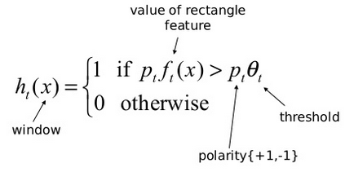

Adaboost algorithm for images
For the Adaboost algorithm for images, let’s define a weak learner $h_{t}\left(x\right)$ :

Slide 58

Viola jones algorithm
Given example images $x_{1},x_{2},..x_{n}$
And given negative or positive values for the above images: $y_{1},y_{2},..y_{n}$ $(y_{i}=0 or 1)$
Initialize weights $w_{1,i},$ to be equal for all i’s (the sum should be 1).

Slide 59

Viola jones algorithm
For t=1 to T
1. For each feature j, train the classifier $h_{j}$ which is restricted to using a single feature.
2. Choose the classifier $h_{t}$ with the lowest error $ε_{t}$:
$$ε_{t}=\sum_{i=1}^{n}{w_{i}\left|h_{t}\left(x_{i}\right)−y_{i}\right|}$$
If $ε_{t}>0.5$ stop (if the lowest error is more than 50% no point to continue)

Slide 60

Viola jones algorithm
(still inside for loop)
3. Update the weights for each example:
$w_{t+1,i}=\left\{\begin{matrix}w_{t,i}β_{t} example x_{i} is classified correctly \\ w_{t,i}, otherwise\end{matrix}\right.$
$β_{t}=\frac{ε_{t}}{\left(1−ε_{t}\right)}$
4. normalize the weights so that $\sum_{i=1}^{n}{w_{t,i}}=1$.
Meaning that $w_{t,i}=\frac{w_{t,i}}{\sum_{j=1}^{n}{w_{t,j}}}$ ($w_{t,i}$ is the probability distribution)

Slide 61

Viola jones algorithm
(outside for loop)
The final strong classifier is:
$h\left(x\right)=\left\{\begin{matrix}1 \sum_{t=1}^{T}{α_{t}h_{t}\left(x\right)}≥λ\sum_{t=1}^{T}{α_{t}} \\ 0 otherwise\end{matrix}\right.$ $λ$=0.5
Where $α_{t}=log\frac{1}{β_{t}}$

Slide 62
Let’s try the algorithm

Slide 63
We’ll use this dataset.
Faces images
Non-faces images
$$y_{i}=1 i=1,2,..,16$$
$$y_{i}=0 i=17,18,..,32$$

Slide 64

Dataset has 16 images of faces and 16 images of non-faces.
All together 32 images.
Each image gets initialized weight $w_{i}=\frac{1}{32} i=1,2,..,32$
Of course in the real dataset it should be thousands of images. This is just for the example.

Slide 65
Let’s test the training set with this feature:

Slide 66

For the feature $f_{1}$=
Let’s define a weak learner:
$h_{1}\left(x\right)=\left\{\begin{matrix}1 if f_{1}\left(x\right)>150 \\ 0 otherwise\end{matrix}\right.$ (polarity=1)
Meaning, the sum of the pixels in the white area minus the sum of the pixels in the black area should be more than150.

Slide 67

$$h_{1}\left(x\right)=\left\{\begin{matrix}1 if f_{1}\left(x\right)>150 \\ 0 otherwise\end{matrix}\right.$$

Slide 68
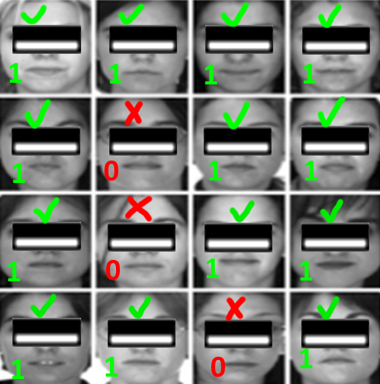

$$h_{1}\left(x\right)=\left\{\begin{matrix}1 if f_{1}\left(x\right)>150 \\ 0 otherwise\end{matrix}\right.$$

Slide 69

$$h_{1}\left(x\right)=\left\{\begin{matrix}1 if f_{1}\left(x\right)>150 \\ 0 otherwise\end{matrix}\right.$$

Slide 70
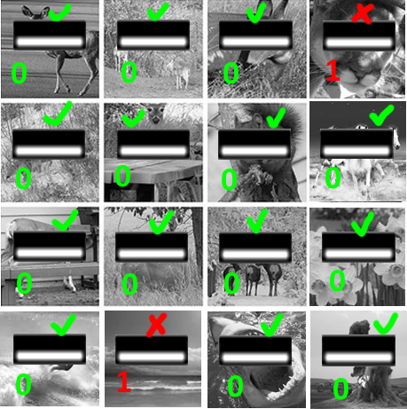

$$h_{1}\left(x\right)=\left\{\begin{matrix}1 if f_{1}\left(x\right)>150 \\ 0 otherwise\end{matrix}\right.$$

Slide 71
Faces images
Non-faces images
For the weak learner $h_{1}\left(x\right)=\left\{\begin{matrix}1 if f_{1}\left(x\right)>150 \\ 0 otherwise\end{matrix}\right.$ defined above, $ε_{1}=\frac{5}{32}=0.156$

Slide 72
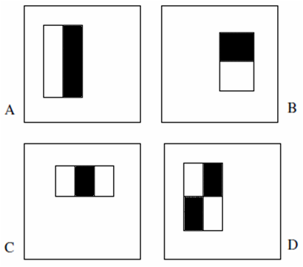
Now let’s test the feature at iteration number k.

Slide 73

For the feature $f_{k}$=
Let’s define a weak learner:
$h_{k}\left(x\right)=\left\{\begin{matrix}1 if {−f}_{k}\left(x\right)>−500 \\ 0 otherwise\end{matrix}\right.$ (polarity=-1)
Or
$$h_{k}\left(x\right)=\left\{\begin{matrix}1 if f_{k}\left(x\right)<500 \\ 0 otherwise\end{matrix}\right.$$
Meaning, the sum of the pixels in the white area minus the sum of the pixels in the black area should be less than 500.

Slide 75
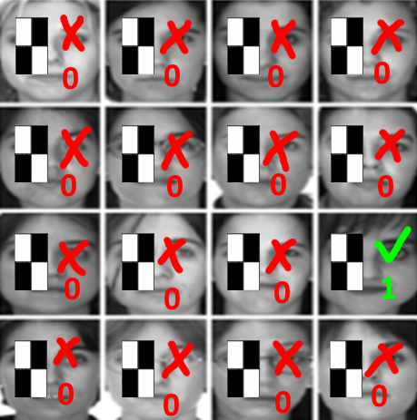

$$h_{k}\left(x\right)=\left\{\begin{matrix}1 if f_{k}\left(x\right)<500 \\ 0 otherwise\end{matrix}\right.$$

Slide 76
$$h_{k}\left(x\right)=\left\{\begin{matrix}1 if f_{k}\left(x\right)<500 \\ 0 otherwise\end{matrix}\right.$$

Slide 77
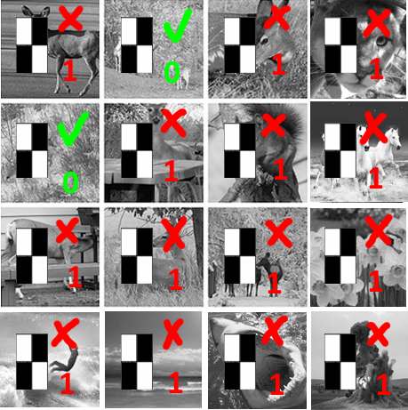
For the weak learner $h_{k}\left(x\right)=\left\{\begin{matrix}1 if f_{k}\left(x\right)<500 \\ 0 otherwise\end{matrix}\right.$ defined above, $ε_{2}=\frac{29}{32}=0.9$

Slide 78

Assume we test T≈160,000 features $(f_{1},f_{2},..f_{T})$ on the dataset above.
Each feature $f_{j}$ has:
A different weak learner $h_{j}$.
A different threshold $θ_{j}$ (calculated only once since it does not consider the images weights).
A different error $ε_{j}$ for the first iteration ($ε_{j}$ changes every iteration since it depends on the images weights)
And assume that the first feature $f_{1}$ had the lowest error.

Slide 79

In this case, all the weights of the images are changed according to this lowest error ($ε_{1}=\frac{5}{32}=0.156$).
$β_{1}=\frac{ε_{1}}{\left(1−ε_{1}\right)}=\frac{0.156}{0.844}$=0.185
Therefore each weight of example $x_{i}$ classified correctly is multiplied by 0.185
$w_{i}=\frac{1}{32}∗0.18=0.0058$ (27 images)
And each weight of example $x_{i}$ classified incorrectly remains unchanged.
$w_{i}=\frac{1}{32}=0.0313$ (5 images)
After normalizations (sum of all weights should be 1):
$w_{i}=0.018$ (27 correct images)
$w_{i}=0.1$ (5 incorrect images)

Slide 80
The weights at the 2nd iteration
Faces images
Non-faces images
w=0.018
w=0.018
w=0.018
w=0.018
w=0.018
w=0.018
w=0.018
w=0.1
w=0.018
w=0.1
w=0.018
w=0.018
w=0.018
w=0.018
w=0.018
w=0.018
w=0.018
w=0.1
w=0.018
w=0.018
w=0.018
w=0.018
w=0.018
w=0.018
w=0.018
w=0.018
w=0.1
w=0.018
w=0.018
w=0.1
w=0.018
w=0.018
$$y_{i}=1 i=1,2,..,16$$
$$y_{i}=0 i=17,18,..,32$$

Slide 81
at the first iteration we found that the best weak learner (with the lowest error) belongs to the feature:
At the next iteration we find the next best weak learner (and update the weights).
And so on and so on.
We stop the loop when the lowest error of the remaining features is more than 50%. At this point there’s no point to continue since all the features left are not good.
After we finish the algorithm we have hundreds of features sorted with weights.

Slide 82

The final strong classifier is:
$h\left(x\right)=\left\{\begin{matrix}1 \sum_{t=1}^{T}{α_{t}h_{t}\left(x\right)}≥λ\sum_{t=1}^{T}{α_{t}} \\ 0 otherwise\end{matrix}\right.$ $λ=\frac{1}{2}$
Where $α_{t}=log\frac{1}{β_{t}}$
The strong classifier means that the sum of weighted weak detectors which succeeded to detect the face should be more that half the sum of all weak detector weights.
For the best weak learner $h_{1}$ (belongs to feature )
$β_{1}$=0.185
$α_{1}=log\frac{1}{β_{1}}=log\frac{1}{0.185}$=1.69
The next $α$ values decrease in each trial.

Slide 83

In each iteration the weights of hard to classify images increase. Therefore, as the number of trials increases, the error rate also increases.
This leads to smaller $α$ values for weak learners selected later in the training process.
The final classification function is the sum of the predictions of the selected weak learners multiplied by the corresponding $α$ values.

Slide 84
In practice no single feature can perform the classification task with low error.
Features which are selected in early rounds of the boosting process had error rates between 0.1 and 0.3.
Features selected in later rounds, as the task becomes more difficult, yield error rates between 0.4 and 0.5.

Slide 85
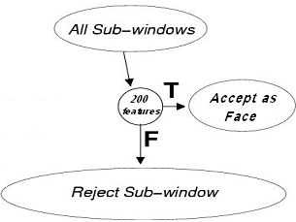
Real-timeliness
We want to detect face as fast as possible. Therefore we don’t want to test all the features received from the adaboost on all images. Instead, we want to spend less time on non-faces images.
For that, we use Cascading classifiers.

Slide 86
Cascading classifiers
Cascade of classifiers allows to quickly discard background regions and concentrate more on object-like regions.

Slide 87
Cascading classifiers
The idea: cascade classifiers with gradually increased complexity.
An image will be labeled as face image only if it survived all the layers in the cascade.
First layer will use, say 2-3 features to filter out obvious non-faces images.
Second layer will use more features to filter out more chanllenging non-faces images.
And so on..
Each layer will be a “strong” classifier obtained using AdaBoost.

Slide 88
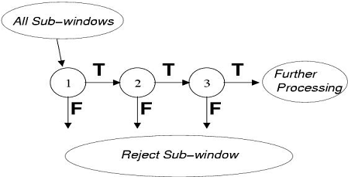
Cascading classifiers - continue

Slide 89

Cascading classifiers - continue
Each layer runs the strong classifier (for the relevant weak classifiers of the layer):
$$h\left(x\right)=\left\{\begin{matrix}1 \sum_{t=1}^{T}{α_{t}h_{t}\left(x\right)}≥λ\sum_{t=1}^{T}{α_{t}} \\ 0 otherwise\end{matrix}\right.$$
Each layer can use different values of $λ$ to get the best results (it depends on the dataset images which values of $λ$ to choose)

Slide 90
Cascading classifiers - continue
Each layer in the cascading classifiers will have:
Different number of features (obtained from AdaBoost) – the user can choose
Different threshold – the user can choose
Also, the number of layers can also be changed
The optimal combination of the above is a complex problem.

Slide 91
Detect a new image
Finally, after training the dataset images and building the cascade, we can try to detect a new image.
The new image is first transferred to the integral image explained above.
Then the image is tested with all the features selected in the adaboost and cascade algorithm (all together much less than 160,000!).
If the image survived all the layers in the cascade, it’s classified as face image, otherwise it’s classified as non-face image.

Slide 92
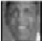
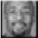
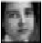
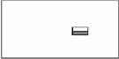
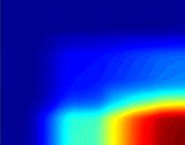
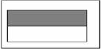
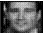
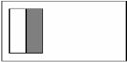
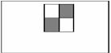
Training phase
Viola & Jones Algorithm - Visualization
Testing phase
Cascade trainer
Classifier cascade framework
Training
Set
(sub-windows)
Integral
Representation
Strong Classifier 1
(cascade stage 1)
Feature
computation
Strong Classifier 2
(cascade stage 2)
AdaBoost
Feature Selection
Strong Classifier N
(cascade stage N)
FACE IDENTIFIED
Notes:
נקודות-
בתהליך הלמידה (לוקח דיי הרבה זמן) נבנה הCascading Classifier (תוך שימוש בAdaBoost ובAttentional Cascade learning)
בתהליך הסיווג (classification) עושים שימוש אך ורק בCascading classifier שנבנה (והחישובים של הfeatures נעשה בעזרת integral image)

Slide 93
Articles/links used
Rapid Object Detection using a Boosted Cascade of simple features. By Paul Viola and Michael Jones.
Generic Object Detection using Adaboost, by Ben Weber.
Face Detection lecture used in the seminar in Haifa University (Supervisor Hagit Hel-Or, by Mor Yakobovits, Roni Karlikar)

Slide 94
Links used for the lectures
Viola Jones face detection and tracking explained: https://www.youtube.com/watch?v=WfdYYNamHZ8
Rob Schapire on Multiclass Boosting https://www.youtube.com/watch?v=L6BlpGnCYVg
VIOLA JONES FACE DETECTION EXPLAINED: https://www.youtube.com/watch?v=_QZLbR67fUU

